Slide 1


Wireless Radar with Visual Graphics using for Under Sea

Slide 2
Abstract :
Fishing is a prehistoric practice dating back at least 70,000 years. Fishing is nothing but the activity of trying to catch fish. Fishing is an activity enjoyed and provides income to those passionate about it. Many challenges were faced by them were food insecurity, lack of fishing equipment, Damage of boats due to rocks, sustainability, resource conversation and management. This work mainly focused on damaging of boats. Nowadays Fishermen use high-contrast lens to monitor the activity of underwater and it helps to find and getaway from any obstacles which harm our boats and it’s a wired lens which connected to the monitor and will look like just a normal graphics and its meter capacity is 10metre only. In this work we are going to use a radar lenses and is wireless which is controlled by a remote sensor to see the underground water of ocean through monitor with meter capacity of 20 meter with an advantage of visual graphics to escape from any harmful rock or substance. It also helps in fishing to catch many fishes.

Slide 3
Actual Problem:
Presently Those who already make a wired sensor to find a finish and big rock in under the sea is good but it’s not to make a graphics clearly and it look like some red and blue dots.There the red dots denotes a big rocks and blue dots are fishes. People use a wired lens and it doesn't show proper status and it has some of mistakes and its have a some Limited distance. The lens show the graphics around 10 meter. Some time its give wrong information or its not shown properly in monitor. The connectivity of monitor and lens is wire so it’s not go many distance and its not cover Surrounding things so we want to move a boat forward and see the picture and move a boat slowly. It also wastes their time.

Slide 4
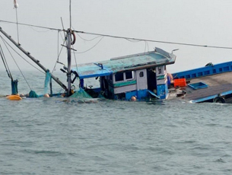
Background of Invention:
Fishing is also a source of income for several people. People use many techniques to catch the fish and to escape from rocks under the sea using lenses as a summary.
However, some unavoidable challenges are presented in the way of using lenses in a practical manner such as low contrast and intensity over pixels, so, that a digital image processing concept is utilized over this logic to provide an appropriate prediction of rocks under the sea as a visual graphics.

Slide 5
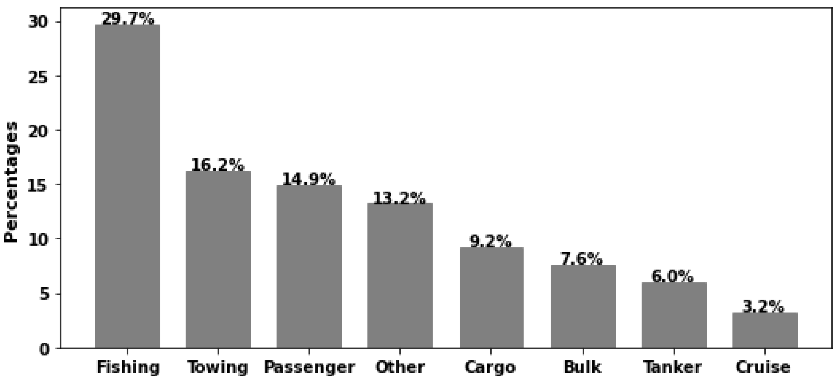
Accident Ratio:
Here is the information about boat accident which is happened and happening at the middle of the sea by crashing with the rocks

Slide 6
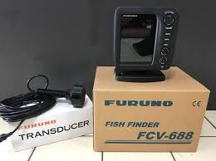
FURUNO FISH FINDER FCV-688
Working Principle of Existing Systems:
The FCV-688's Bottom Discrimination feature enables the fish finder to indicate if a major component of the bottom is mud, sand, gravel or rocks.
A fish finder uses this ultrasonic reflection characteristic. The ultrasonic waves from the fish finder are transmitted directly underneath the boat. If they hit a fish school, very weak reflections will come back to where the ultrasonic waves were originally transmitted.

Slide 7
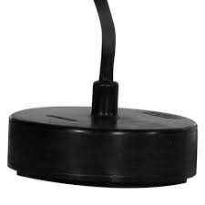
Furuno Transducer And Its Working Principle:
An FCV transducer, short for Forward Looking Sonar (FLS) transducer, doesn't directly convert energy itself.
It's a part of a larger system that uses sound waves to create an image on a fish finder.
It finder uses the distance information from multiple readings to create an image on the screen, showing the location of fish and other objects in the water column.

Slide 8
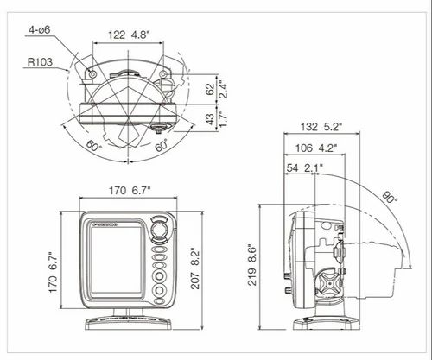
Brief Explanation Of Drawings:
Frequency
50 and 200 kHz
Transducer
600 W
Range Scale
2-1200 m
Pulse length & PRR
0.1-3 ms, Max 3,000 pulse/min
Display Mode
Single frequency (50 or 200 kHz), Dual-frequency, Zoom, Nav data, A-scope, Marker zoom, Bottom zoom, Bottom-lock, Bottom discrimination, ACCU-FISH™
Display Unit
CV-688E (for English)
Range Shift
Bottom-lock expansion: 2-10 m
Sectional expansion: 2-1200 m

Slide 9
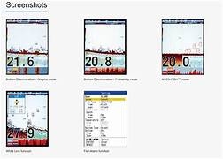
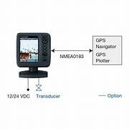
Information for working of FCV-688:

Slide 10
Limitations Of The Existing System:
Cost: High-end fish finders like the FCV-688 can be expensive, which may be a barrier for some users, especially recreational fishermen or smaller boat owners who have budget constraints.
Complexity: The advanced features and settings of the FCV-688 may be overwhelming for beginners or users who are not familiar with fish finder technology. It may take time to learn how to use all the features effectively.
Power Consumption: Fish finders like the FCV-688 can consume a significant amount of power, especially if used extensively. This may require additional battery capacity or careful management of power resources on board.

Slide 11
Maintenance: Regular maintenance is necessary to ensure the fish finder continues to operate at peak performance. This includes cleaning the transducer, checking connections, and updating software or firmware as needed.
Display Size: While the FCV-688 typically features a decent-sized display, some users may prefer larger displays for better visibility, especially in challenging lighting or weather conditions.
Dependence on Water Conditions: Like all sonar-based devices, the effectiveness of the FCV-688 can be affected by water conditions such as turbulence, salinity, and temperature variations, which may impact sonar performance.

Slide 12
Proposed Invention:
In this work we invert the wireless lens and Wi-Fi connection monitor for seeing the video graphics. It’s mainly used for fisherman for fishing and detecting a rocks in under a sea because the rocks are damaged the boats for that the fisherman’s gets a loss in their life. And in our work it’s easy to handle and it gives a clear view. Because we are using a camera lens like a drone camera so it’s very easy to handle and can increase the destination for Wi-Fi connection in our device.
In this invention we use a Waterproof Camera. In this camera its have a *24 LED lights and AHD Camera and the camera is covered by Metal Case and 100° Viewing Angle. It’s very useful for fisherman’s to detect a fishes and rocks.

Slide 13
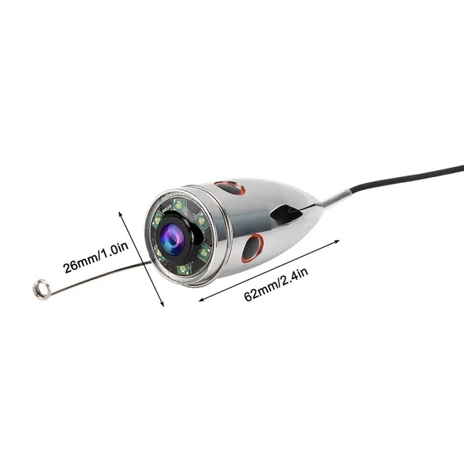
Wireless Wi-Fi Waterproof Video Camera:
Our Wireless Wi-Fi Waterproof Video Camera. Built for resilience and versatility, this advanced camera seamlessly connects to your Wi-Fi network, ensuring real-time streaming and remote access from any device.
It withstands dust and can be submerged beyond 1 meter, making it ideal for all-weather monitoring and underwater exploration. Capture vivid HD video day or night with enhanced night vision capabilities.

Slide 14
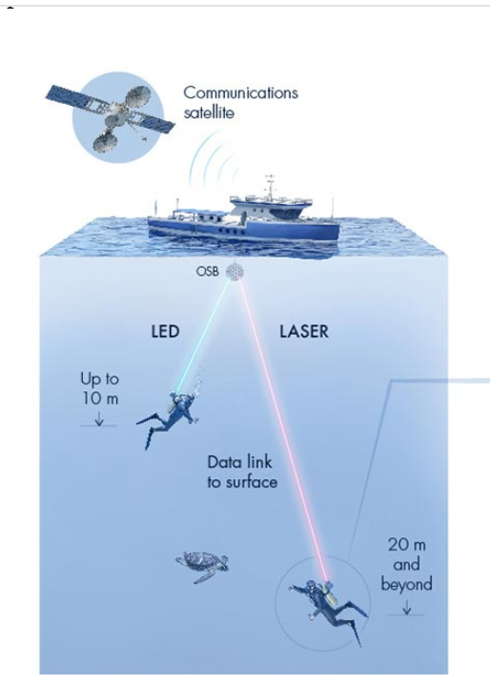
Aqua Fi Methodology:
Underwater communication is possible with radio, acoustic and visible light signals. However, radio can only carry data over short distances, while acoustic signals support long distances, but with a very limited data rate. Visible light can travel far and carry lots of data, but the narrow light beams require a clear line of sight between the transmitters and receivers.
Like this methodology, we use Wi-Fi chip to connect both the camera and the monitor. We have created a relatively cheap and flexible way to connect underwater environments to the global internet. The connection is possible through wireless Wi-Fi chip by connecting to it also by attaching SIM cards or through HDMI cables.

Slide 15
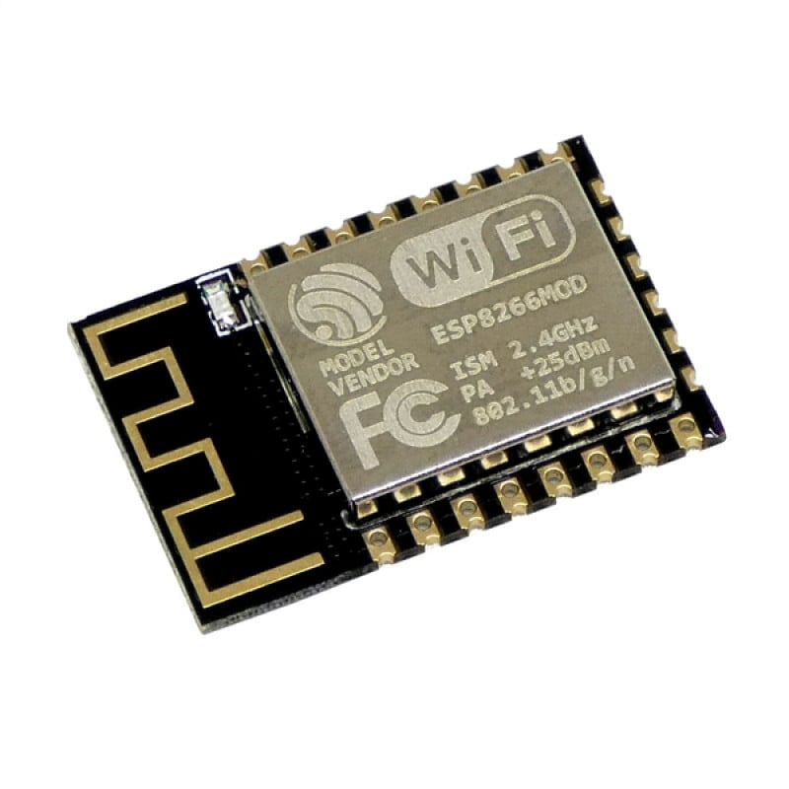
Wi-Fi Chip:
Wi-Fi chip, also known as a Wi-Fi module or WiFi adapter, is a piece of hardware that allows devices like computers, smartphones, and other electronics to connect to wireless networks. It contains the necessary circuitry and components to communicate wirelessly using WiFi standards.

Slide 16
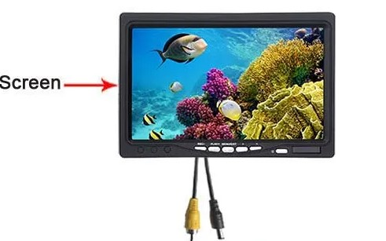
Wide Viewing Angle TFT HD Monitor:
【Wide Viewing Angle TFT HD Monitor】— This fish camera features a high-resolution TFT color monitor, making images brighter and more lifelike. With an ultra-wide angle of 165°/175°, the brightness and color of the screen will not change even when viewed from an angle.
The time it takes for a pixel to change from one color to another, measured in milliseconds (ms). Lower response times reduce motion blur, crucial for fast-paced gaming.

Slide 17
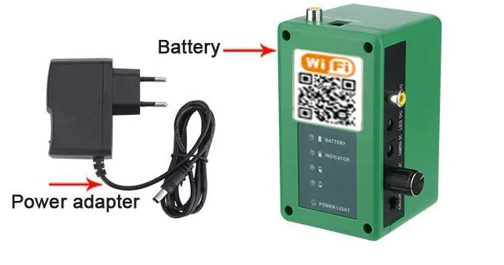
Built-In 5000mah Battery:
【Built-In 5000mah Battery】— This visual fish finder has a built-in 5000mAH rechargeable battery, which can be used continuously for 4-6 hours when fully charged; it can also be charged with a power bank, which is convenient for outdoor use.
The built-in battery provides extended usage times, enhancing productivity and convenience during meetings, presentations, or outdoor shoots. With versatile connectivity options and high-resolution displays, these monitors combine functionality with portability.

Slide 18
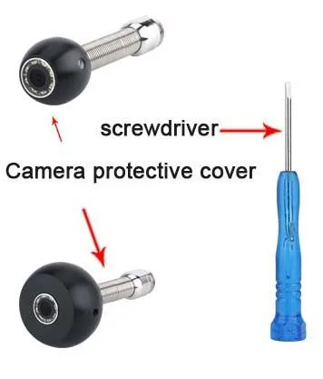
Camera Protective cover:
The primary purpose of a camera protective cover is to shield the camera lens from dust, dirt, moisture, and scratches when the camera is not in use. This helps maintain the optical clarity of the lens and prevents damage that could affect image quality

Slide 19
Working Methodology Of Proposed Systems:
The wireless Radar with visual graphics using under sea. In this work we use a Waterproof Camera and Wi-Fi connection monitor with waterproof protection. First thing is to connect the Lens to the monitor by Wi-Fi and a main thing is it’s fully used by DC current.
Step 1 : We have to take a camera and put on sea and we control by a monitor
Step 2: in the monitor we see the video taken by camera under the sea and it’s graphics are look very clearly and there is no lag .

Slide 20
Step 3 : The Wi-Fi connection destination is 50 m and the lens video taking capabilities is 30 m because it’s used to see the rocks under the sea .
Step 4: We make a boats to move and we move the camera by using a remote control in monitor. This work helps in fisherman’s daily life.

Slide 21
Flowchart:
Wireless Water Proof
Camera
WiFi
Chip
Wide Viewing Angle TFT HD Monitor
Built-In
5000mah Battery
Camera Protective
Cover
Proposed Device

Slide 22

Competiting Companies:

Slide 23
Marketing Strategy :
Our main focus if this work is to reach the fishermen as our clients and its strategy to give it as a Cost efficient, Long life of the battery, Long lasting consistency of working, Vision free and Easy to Handle.
And the approximate amount to sell the product is 50,000 Rupees, Because of the high quality lenses and monitor.

Slide 24
Conclusion:
Wireless Radar with visual graphics using for undersea claims to provide an efficient prediction scheme to identify the rocks at earlier stages with proper accuracy and in less time.
Wireless Radar with visual graphics using for undersea includes a multi-layer prediction architecture wherein a multilayer prediction architecture is an intelligent architecture that is considered to process monitoring and train the model accordingly for any best testing possibilities.
Thus We concludes that our work will make a huge impact on fishermen’s life by its cheap price, Energy efficient ,High capacity to monitor and is wireless .

Slide 25


